Slide 1

SIG JS Tooling
08-08-2019

Slide 2
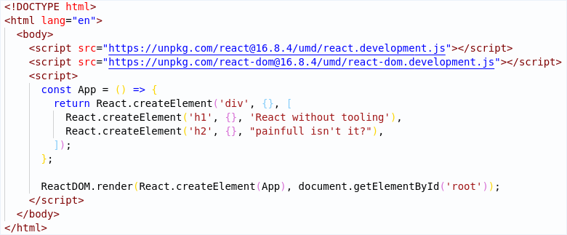
What would life be like without tooling?
JS Tooling
2

Slide 3
What is Tooling
Tooling is the catch-all term for libraries, scripts, frameworks, packages, etc which make your life as a developer easier
JS Tooling
3

Slide 4













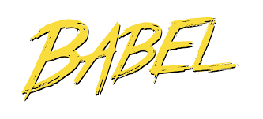

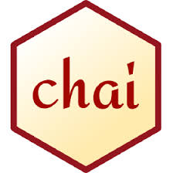




Linters
Types of Tooling
Runners
Bundlers
Transpilers
Testing frameworks
JS Tooling
4

Slide 5
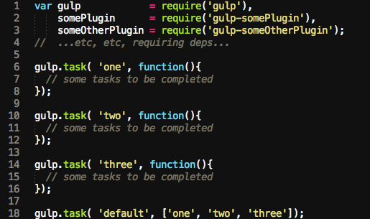
Task Runners
Orchestration of other tools
Achieved through plugins
Problematic in maintenance
Runners are not used in modern js. NPM scripts are used instead.
JS Tooling
5

Slide 6

NPM
Dependencies
Scripts
Config
Project information
JS Tooling
6
Notes:
NPM Scripts; Package.json

Slide 7
Bundlers
Bundling
Code splitting
Hot reload
Minification
JS Tooling
7

Slide 8
Bundlers
Standard output to ES2015
Excellent dead code elimination
JS only out of the box
No HMR
Easier config than webpack
Faster than webpack
Very flexible
Production quality builds
JS only out of the box
HMR with plugin
No config
Very fast
Support various filetypes out of the box
HMR out of the box
JS Tooling
8
Notes:
Parcel hobbyproject weinig configuraties nodig; webpack productie project; rollup library project

Slide 9
Transpilers
JS Tooling
9

Slide 10
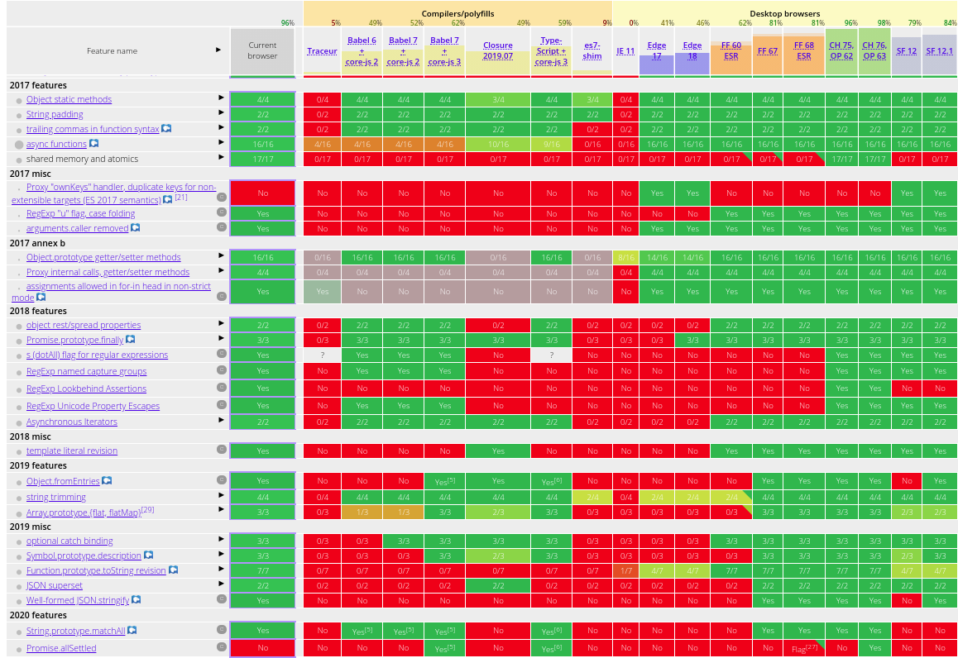
ES2016+
JS Tooling
10

Slide 11
Linters
JS Tooling
11

Slide 12
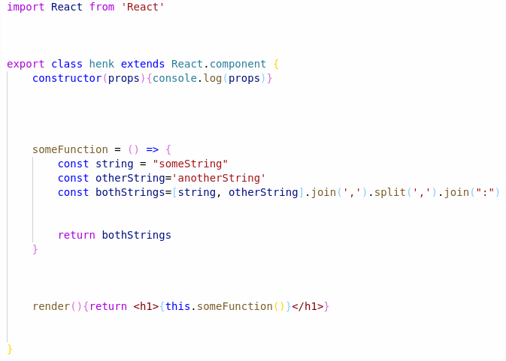
Prettier & Editorconfig
JS Tooling
12

Slide 13
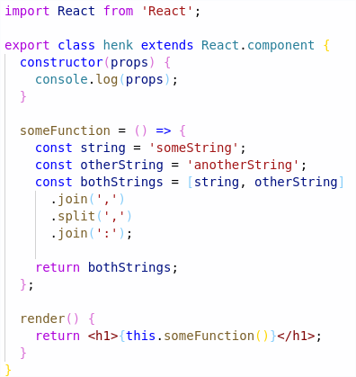
Prettier & Editorconfig
JS Tooling
13

Slide 14
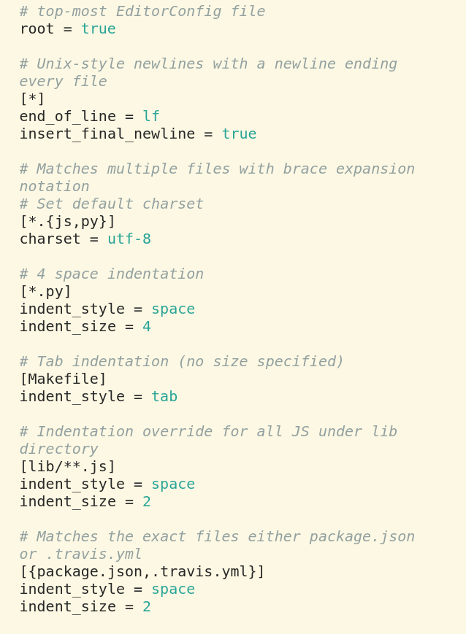
Prettier & Editorconfig
JS Tooling
14

Slide 15
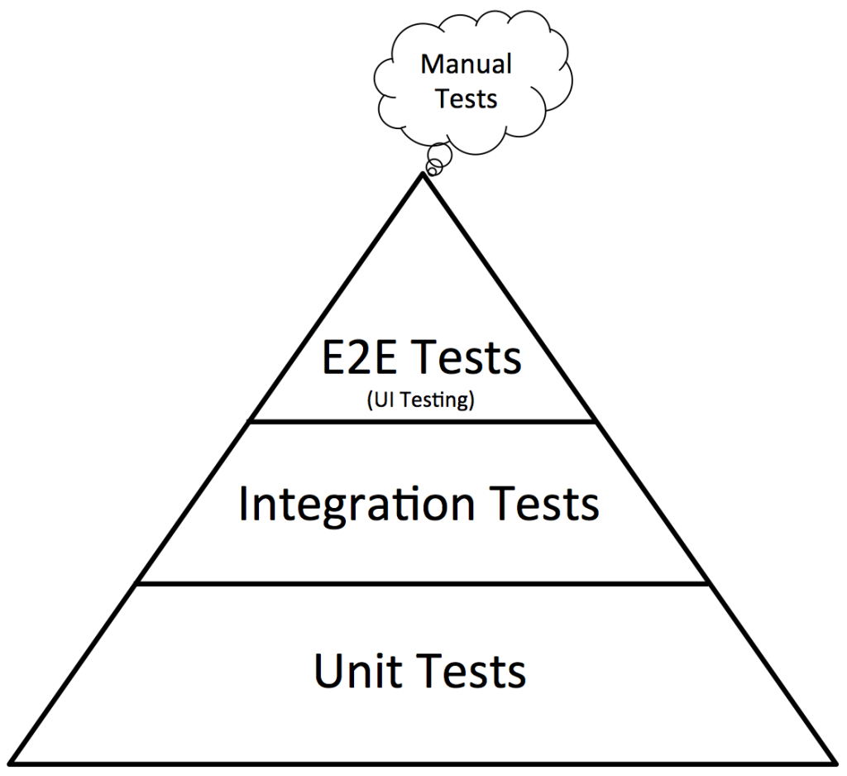
Testing
JS Tooling
15

Slide 16


Testing
JS Tooling
16

Slide 17
Testing
JS Tooling
17

Slide 18
Testing
Testing structure (Mocha, Jasmine, Jest)
Asserters (Chai, Jasmine, Jest)
Runner (Mocha, Jasmine, Jest, Karma)
Mocks/Spies/Stubs (Sinon, Jasmine, Enzyme, Jest)
Code Coverage (Istanbul, Jest, Blanket)
Flexible
Fast
Easy setup
JS Tooling
18

Slide 19

Dinner & Hands On
It’s dinnertime!
React
19

